Slide 1

Compiling historical TRAFFIC data to predict future traffic LEVELS in makati

Slide 2
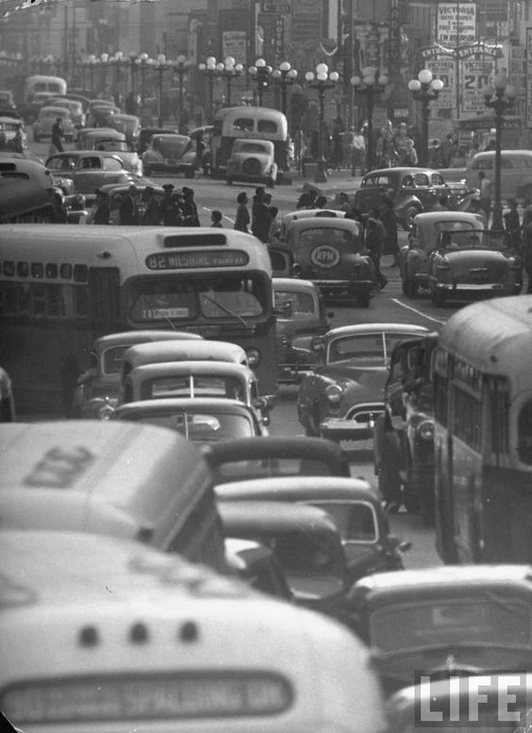



The deterioration of transport and traffic condition has afflicted Metro Manila since the 1950s
Lack of public transportation services
Poor enforcement of traffic regulation
Lack of discipline

Slide 3

40% registered vehicles in the country are piling in Metro Manila
1.1 million private and “for-hire” vehicles
According to Manasan & Mercado (1999)

Slide 4
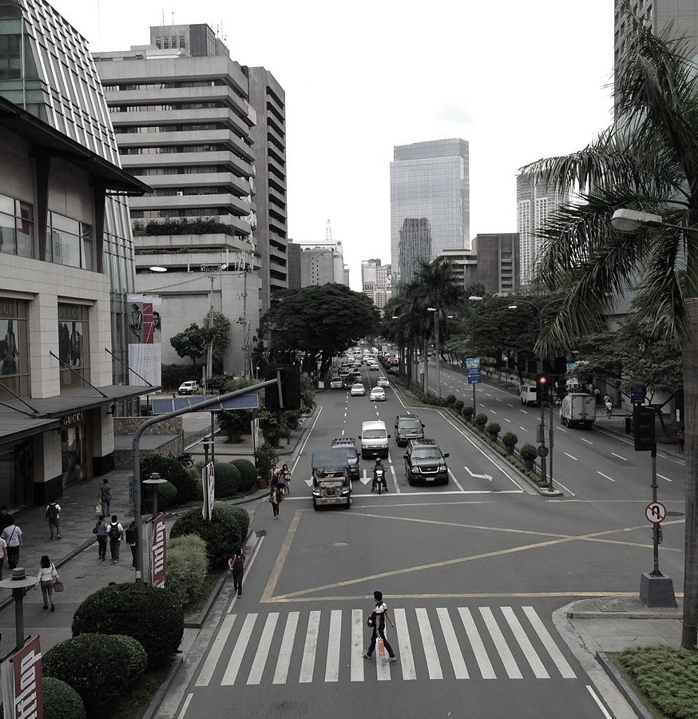
MAKATI
Financial center in the Philippines
Major in cultural and entertainment hub
High volume of road users

Slide 5

GATEWAYS OF MAKATI CITY
170,000 vehicles per day along the Guadalupe Bridge to Sen. Gil Puyat Avenue
136,000 vehicles per day along C5 to Kayalaan Avenue and Fort Bonifacio
115,000 vehicles per day within the Don Bosco area
75,000 vehicles per day within the segment south to Sen. Gil Puyat Avenue
http://www.makati.gov.ph/portal/main/index.jsp?main=2&content=0&menu=0

Slide 6

“Predicting better than pure guesswork, even if not accurately, delivers real value. A hazy view of what’s to come outperforms complete darkness by a landslide. The Prediction Effect: A little prediction goes a long way.” -Eric seige

Slide 7
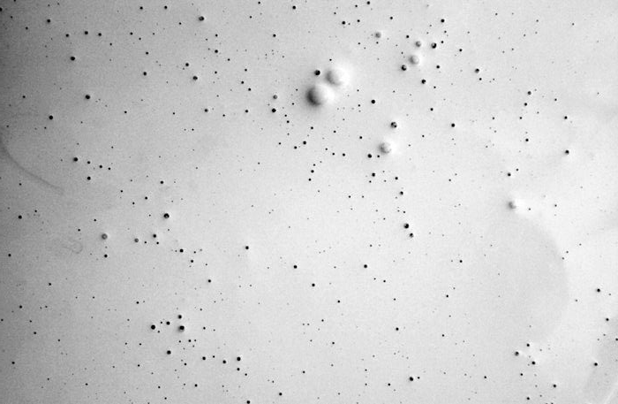
RESEARCH QUESTION
How can an analytical/deterministic tool generate traffic prediction level?

Slide 8
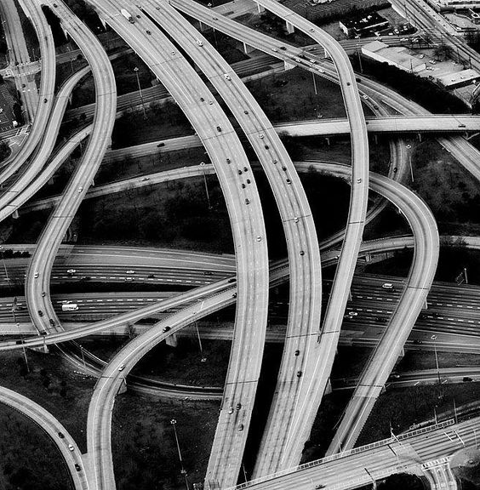
PURPOSE AND DESCRIPTION
It is constantly helpful to further improve previous methods which were in some cases developed based on relatively poor information of traffic conditions.

Slide 9
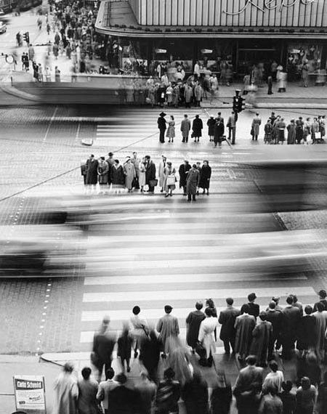
Retrieve historical data to gain performance insights and understand patterns of behavior of traffic
OBJECTIVES
Predict future traffic levels up to a week into the future

Slide 10

SCOPE AND LIMITATIONS
The accuracy of the model will not yield a 100% result due to risks such as data inconsistency and tools. Nonetheless, the researchers will still be giving the probability of the event.

Slide 11

Related literature

Slide 12

‘Utilizing Real-World Transportation Data for Accurate Traffic Prediction’
- Pan, Demiryurek and Shahbi
‘Predicting Expected Road Traffic Conditions based on Historical and Current Data’
- Scofield, Cahn, Hersch, Stoppler, Yakich, Huang & Barker
‘Using Location Data to Determine Traffic and Route Information’
- Nagda, Li, Howlett, Fan, Yang, Fay
‘Representative Road Traffic Flow Information based on Historical Data’
- B. Downs, S. Hersch, C. Chapman

Slide 13

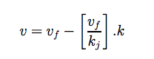
Related literature
Greenshield’s Model
Where:
V = mean speed at density k,
Vf = free speed
Kj = jam density.
http://www.webpages.uidaho.edu/niatt_labmanual/chapters/trafficflowtheory/professionalpractice/GreenshieldsModel.htm

Slide 14

TECHNICAL BACKGROUND

Slide 15

Predictive Analytics
JavaScript
Java
PostgreSQL
RESTful API

Slide 16

REQUIREMENT ANALYSIS
Quantitative Approach where the emphasis is on collecting and analyzing numerical data;

Slide 17

DATA GATHERING PROCEDURE

Slide 18
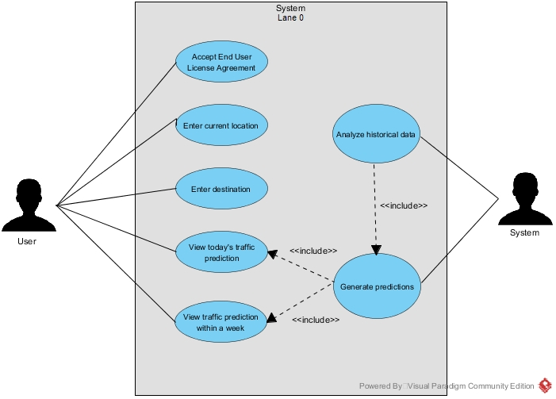
USE CASE DIAGRAM

Slide 19
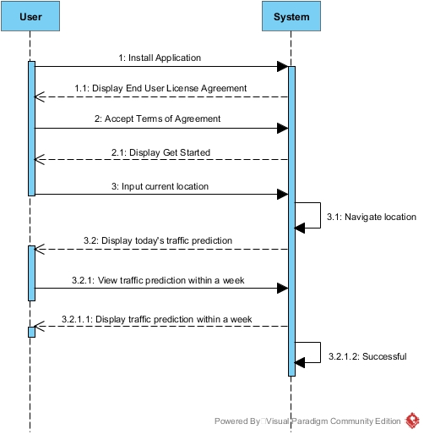
SEQUENCE DIAGRAM

Slide 20
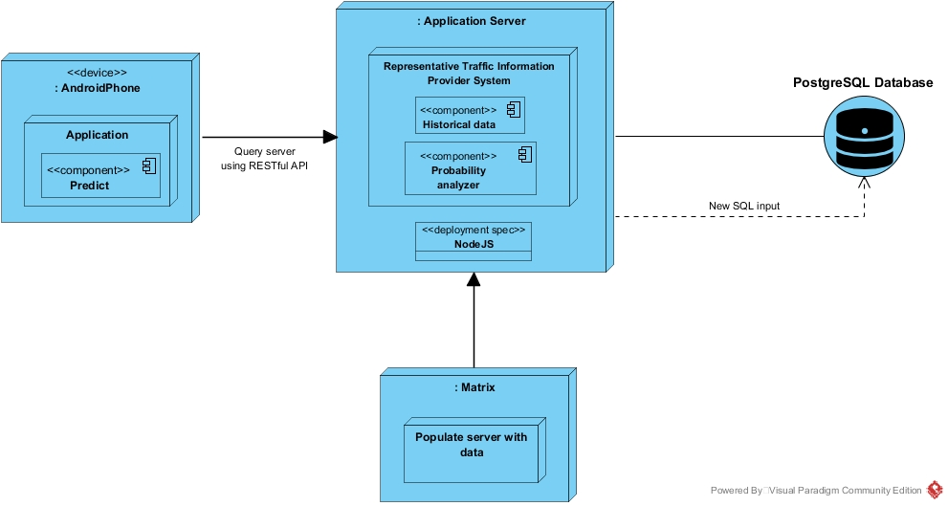
DEPLOYMENT DIAGRAM

Slide 21

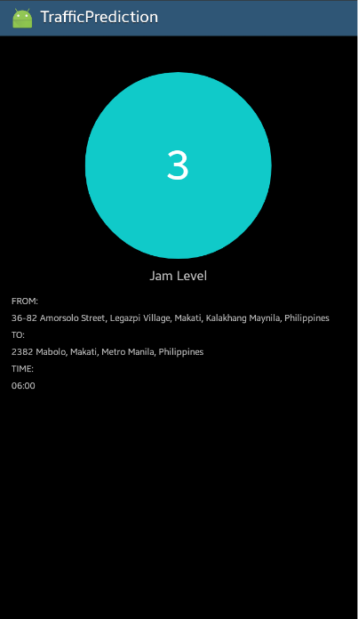
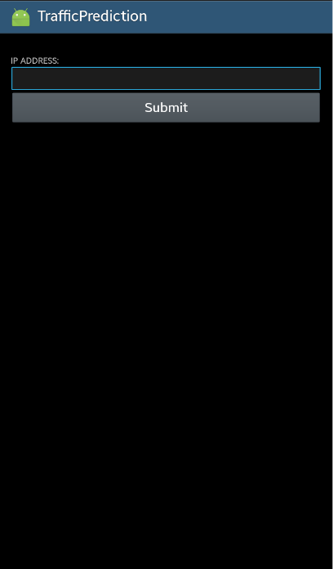
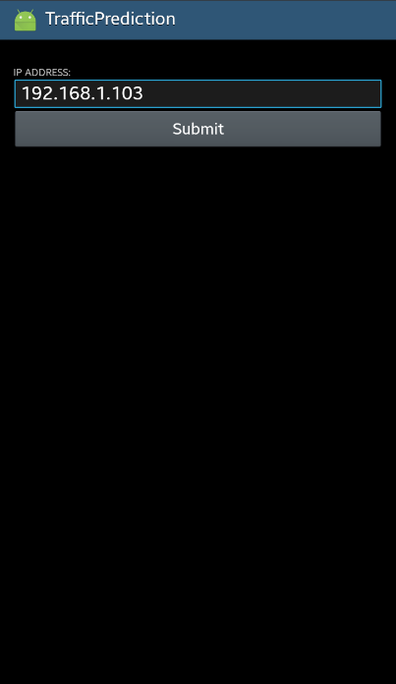
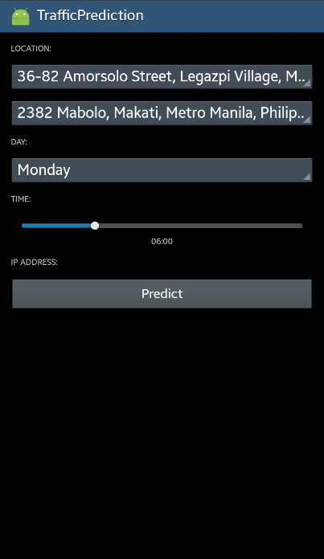
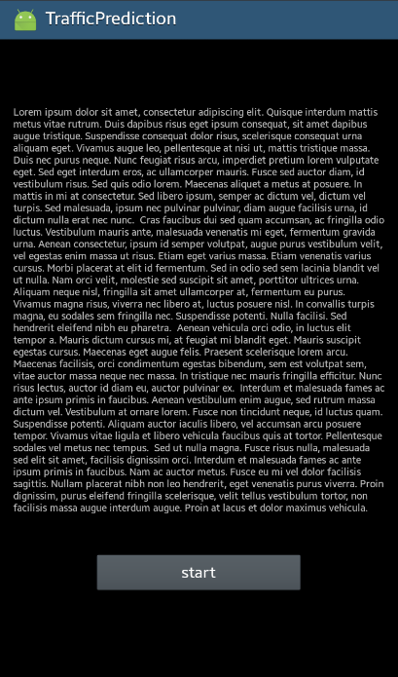
DESIGN OF SOFTWARE AND SYSTEM

Slide 22

Gap analysis

